Slide 1
Bio& 241
Unit 1 / Lecture 1

Slide 2
Scientific Method
Bacon (1561-1626) and Descartes (1596-1650)
  new habits of scientific thought
England and France
  academies of science --still exist today
Science
  produces reliable, objective and testable information about nature

Slide 3
Inductive Method
A process in which numerous experimental observations are made until investigators are confident enough to make generalizations and predictions from the data. What we hold as truth in Anatomy is based upon inductive reasoning.
Proof in science in dependent on:
  reliable observations
  Repeatedly tested data
  not falsified by any credible observation
  Falsifiability is the logical possibility that an assertion can be shown false by an observation or a physical experiment. That something is "falsifiable" does not mean it is false; rather, that if it is false, then this can be shown by observation or experiment
In science, all truth is tentative
  “proof beyond a reasonable doubt”

Slide 4
Hypothetico-Deductive Method
This method involves the development of a Hypothesis, an educated speculation or reasonable answer to a specific question. Most of what we hold as truth in Physiology comes from this method
A Good hypothesis is:
  consistent with what is already known regarding a question
  testable through experiments and observations
  falsifiable with credible evidence and observations
Hypotheses are written as If-Then statements:
  If these observations are correct
  Then this should be the outcome.

Slide 5
Deductive Reasoning or Logic
Reasoning which constructs or evaluates deductive arguments. An argument is valid when it is impossible for both its premises to be true and its conclusion to be false.
Consider the following arguments:
All men are mortal
Socrates is a man
(Therefore) Socrates is mortal
and
Only quarterbacks eat steak.
John eats steak.
(Therefore,) John is a quarterback
In which is the premise and conclusion both correct? Which argument is sound?

Slide 6
Proper Experimental Design
Sample size
  sufficient to prevent chance event
Control group and treatment group
  identical treatment except for the variable being
  tested
  independent variable is typically the variable being manipulated or changed
  dependent variable is the observed result of the independent variable being manipulated.
Prevention of psychosomatic effects
  use of placebo in control group
Experimenter bias
  prevented with double-blind study

Slide 7
Proper Experimental Design
Statistical testing
  difference between control and test subjects was not random variation
  due to the variable being tested
Peer Review
Critical evaluation by other experts in the field
  done prior to funding or publication
  done by using verification and repeatability of results
Ensures honesty, objectivity and quality in science

Slide 8
Facts, Laws and Theories
Scientific fact
  information independently observed and verified
Law of nature
  description of the way matter and energy behave
  results from inductive reasoning and repeated observations
  written as verbal statements or mathematical formulae
Theory
  summary of conclusions drawn from observable facts
  Not merely a guess or conjuecture
  it provides explanations and predictions

Slide 9
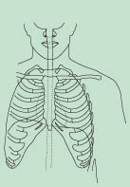
An Introduction to the Human Body
Anatomy
  science of structure
  relationships revealed by dissection (cutting apart)
  imaging techniques
Physiology
  science of body functions
  normal adult physiology is studied in this class
  some genetic variations occur

Slide 10
ANATOMY AND PHYSIOLOGY DEFINED
Anatomy
  the study of structure and the relationships among structures.
Subdivisions
  surface anatomy, gross anatomy, systemic anatomy, regional anatomy, radiographic anatomy, developmental anatomy, embryology, cytology, and pathological anatomy

Slide 11
ANATOMY AND PHYSIOLOGY DEFINED
Physiology
  the study of how body structures function
Subdivisions of physiology include
  cell physiology, systems physiology, pathophysiology, exercise physiology, neurophysiology, endocrinology, cardiovascular physiology, immunophysiology, respiratory physiology, renal physiology, and reproductive physiology

Slide 12
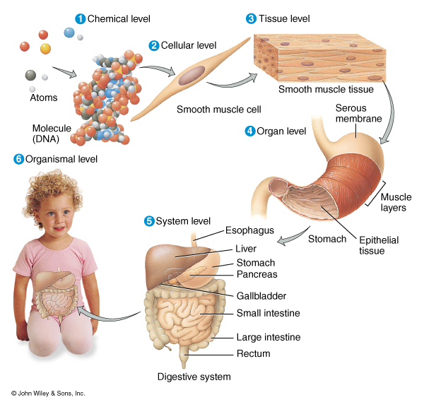
Structural Organization of Matter
Chemical Level
a. Atoms
(Proton, Neutron, electrons)
NOTE: 95% of the atomic structure of humans is four atoms: oxygen, carbon, hydrogen, and nitrogen.
  65% oxygen atoms
18% carbon atoms
10% hydrogen atoms
3% nitrogen atoms
2% calcium atoms
1% phosphorus atoms

Slide 13
Structural Organization of Matter
b. Molecules
Two or more atoms joined together by either:
  covalent: shared electrons
  ionic bonds: loss or gain of electrons
In Humans, most common molecule is WATER which makes up about 60-70% of our total molecular composition.
  Water is formed by polar covalent bonds.
4 biologically important organic molecules in the human body
a. Proteins which are made from 20 different Amino Acids

Slide 14
Structural Organization of Matter
Four Biologically-Important Organic molecules:
b. Complex Carbohydrates
made from simple sugars
c. Nucleic Acids made for nucleotides
d. Lipids made from fatty acids and glycerol
2. Cells
(Smallest structural and functional units of the human body)

Slide 15
Structural Organization of Matter
Tissues
(group of cells and the materials surrounding them that work together to perform a particular function)
Organs
(composed of two or more tissues work together to provide specific functions and they usually have specific shapes)

Slide 16
Structural Organization of Matter
Organ systems
(consist of one or more organs that provide a common function) Examples covered in Anatomy & Physiology 241:
a. Integumentary system
b. Skeletal system
c. Muscular system
d. Nervous system

Slide 17
Structural Organization of Matter
Anatomy & Physiology 242:
e. Endocrine system
f. Cardiovascular system
g. Lymphatic system
h. Respiratory system
I. Digestive system
j. Urinary system
k. Reproductive system

Slide 18
Basic Life Processes
High level of organization
Composed of Cells
Either prokaryotic or Eukaryotic
3. Metabolism
Sum of all biochemical processes of cells, tissues, organs, and organ systems
4. Responsiveness/Movement
Ability to detect and respond to changes in the internal and external environment
Movement occurs at the intracellular, cellular, organ levels

Slide 19
Basic Life Processes
Homeostasis
ability to maintain Equilibrium of the body’s internal environment
6. Differentiation/Growth
Process a cell undergoes to develop from a unspecialized to a specialized cell. Increase in number of cells, size of cells, tissues, organs, and the body. Single cell to multicellular complex organism
7. Reproduction
Formation of new cells for growth, repair, or replacement, or the production of a new individual.

Slide 20
Basic Life Processes
Evolution: Genetic Change within populations from generation to generation due to genetic mutations and natural selection.
Examples: Antibiotic bacteria (MRSA) methicillin-resistant Staphylococcus aureus. It's a strain of staph that's resistant to the broad-spectrum antibiotics commonly used to treat it. MRSA can be fatal.
Most MRSA infections occur in hospitals or other health care settings, such as nursing homes and dialysis centers. It's known as health care-associated MRSA, or HA-MRSA. Older adults and people with weakened immune systems are at most risk of HA-MRSA. More recently, another type of MRSA has occurred among otherwise healthy people in the wider community. This form, community-associated MRSA, or CA-MRSA, is responsible for serious skin and soft tissue infections and for a serious form of pneumonia.

Slide 21
Basic Life Processes
Homeostasis
produced by the interaction of organ systems and regulatory processes (feedback systems).
Homeostasis is a dynamic condition in response to changing conditions.
The two body systems that largely control the body’s homeostatic state:
1. Nervous system
2. Endocrine system

Slide 22
Control of Homeostasis
Homeostasis is continually being disrupted by
  external stimuli
    intense heat, cold , and lack of oxygen
  internal stimuli
    psychological stresses
    exercise
Disruptions are usually mild & temporary
If homeostasis is not maintained, death may result

Slide 23
CONTROL OF HOMEOSTASIS
Homeostatic imbalances occur because of disruptions from the external or internal environments.
  The nervous system detects changes and sends nerve impulses to counteract the disruption.
  nerve impulses cause rapid changes
  The endocrine system regulates homeostasis by secreting hormones.
  hormones usually work more slowly.
Examples: CO2, O2, temperature, pH, blood pressure, …

Slide 24
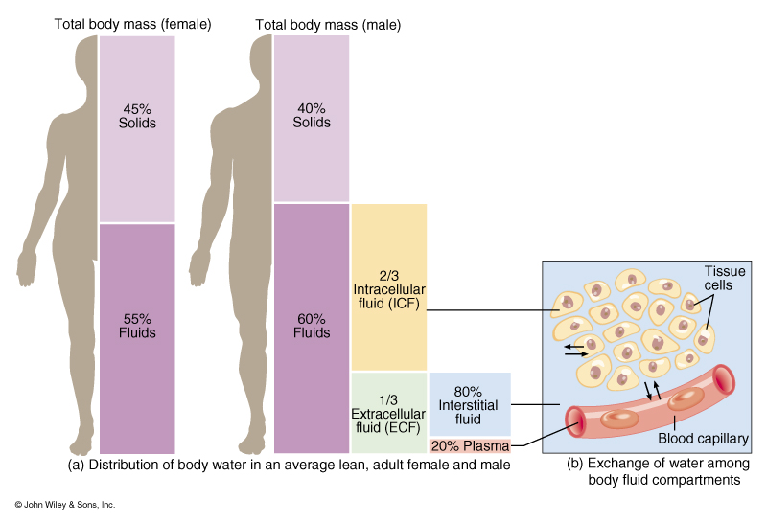
Example of Homeostasis
Fluid balance in the Body
Compartments for Body Fluids
Intracellular
Extracellular
a. Interstitial
b. Plasma

Slide 25
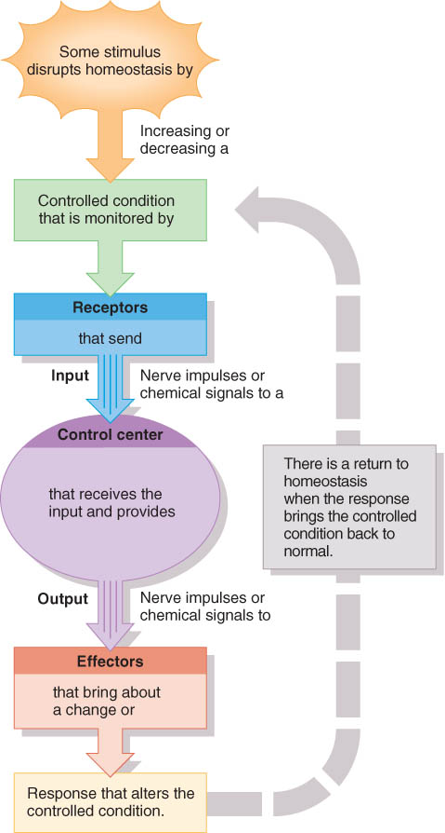
Components of Feedback Loop
Receptor
  monitors a controlled condition
Control center
  determines next action
Effector
  receives directions from the control center
  produces a response that changes the controlled condition

Slide 26
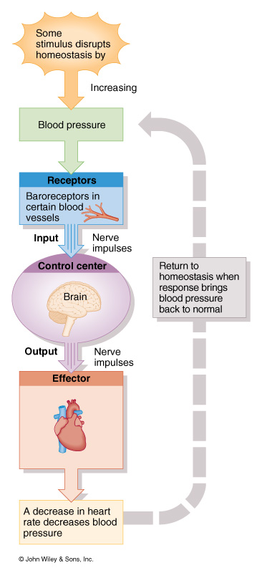
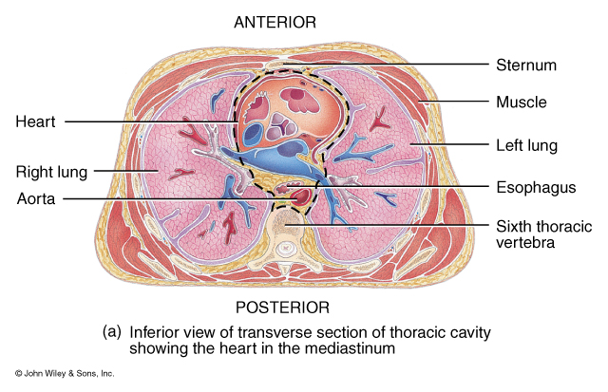
Basic Components of a Negative Feedback System

Slide 27
Positive Feedback Loops
Self-amplifying change
  leads to change in the same direction
Normal way of producing rapid changes
  occurs with childbirth, blood clotting, protein digestion, and generation of nerve signals

Slide 28
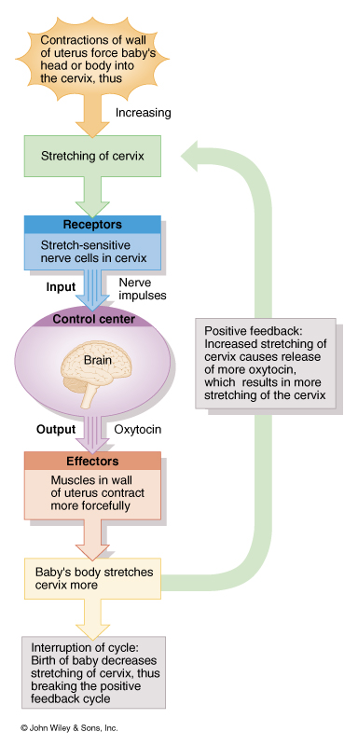
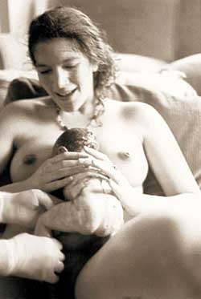
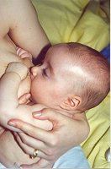
Basic Components of a Positive Feedback System

Slide 29
Homeostatic Imbalances
Disruption of homeostasis can lead to disease and death.
Disorder is a general term for any change or abnormality of function.
Disease is a more specific term for an illness characterized by a recognizable set of signs and symptoms.
  A local disease is one that affects one part or a limited region of the body.
  A systemic disease affects either the entire body or several parts.

Slide 30
Homeostatic Imbalances
Disease is a more specific term for an illness characterized by a recognizable set of signs and symptoms.
  Signs are objective changes that a clinician can observe and measure; e.g., fever or rash.
  Symptoms are subjective changes in body functions that are not apparent to an observer; e.g., headache or nausea.
Diagnosis is the art of distinguishing one disease from another or determining the nature of a disease; a diagnosis is generally arrived at after the taking of a medical history and the administration of a physical examination.

Slide 31
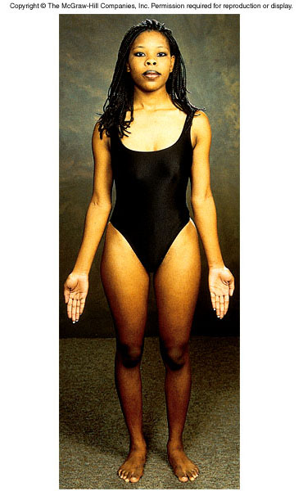
Anatomical Position
The anatomical position is a standardized method of observing or imaging the body that allows precise and consistent anatomical references.
When in the anatomical position, the subject stands (Figure 1.5).
  standing upright
  facing the observer, head level
  eyes facing forward
  feet flat on the floor
  arms at the sides
  palms turned forward (ventral)

Slide 32
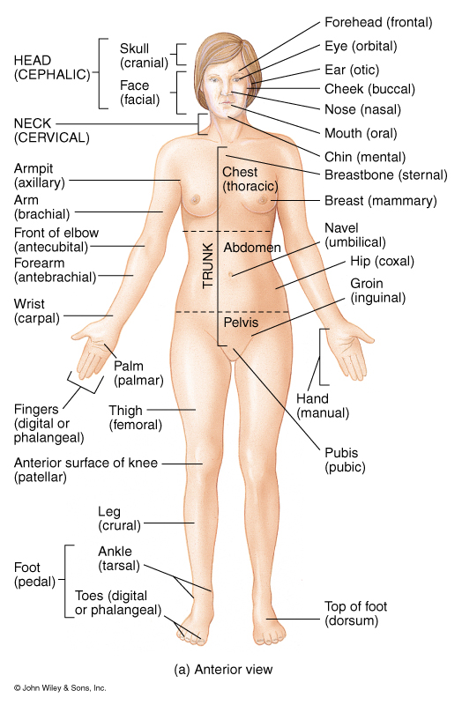
Basic Anatomical Terminology

Slide 33
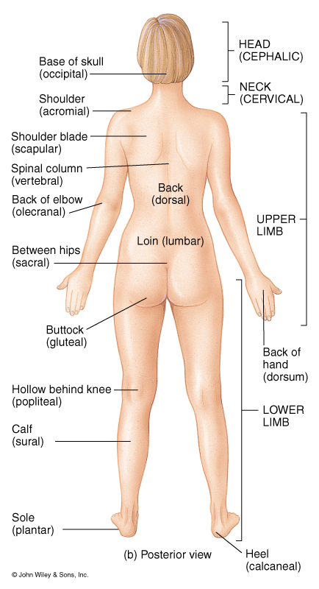
Basic Anatomical Terminology

Slide 34
Reclining Position
If the body is lying face down, it is in the prone position.
If the body is lying face up, it is in the supine position.

Slide 35
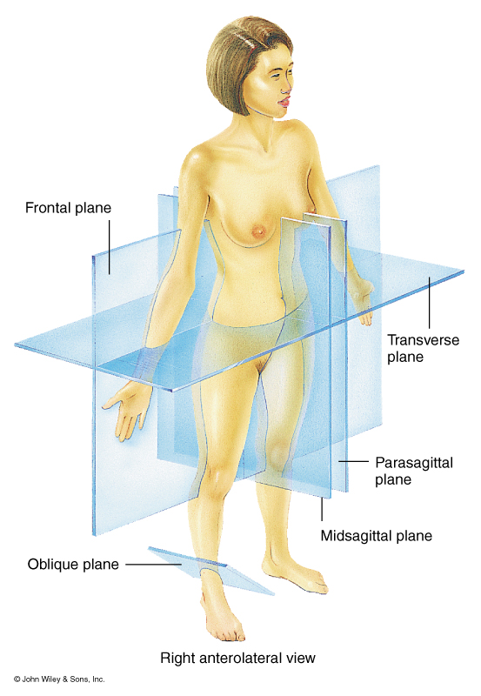
Basic body planes or sections
These terms are used for planes or sections that cut the body, organs, tissues, or cells

Slide 36
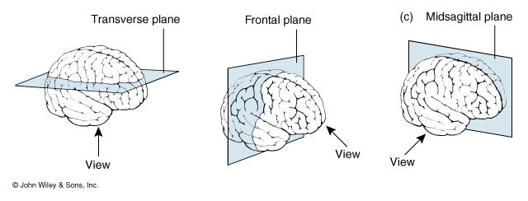
Example of how planes would cut the brain

Slide 37
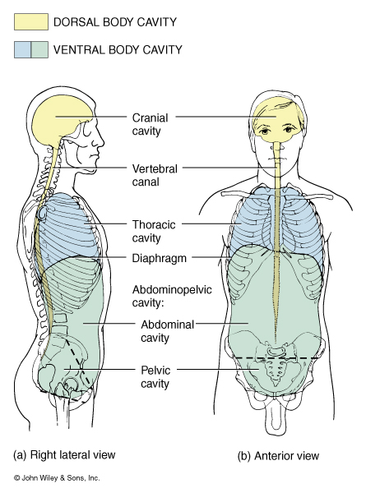
Two Principal Body Cavities and their Subdivisions

Slide 38
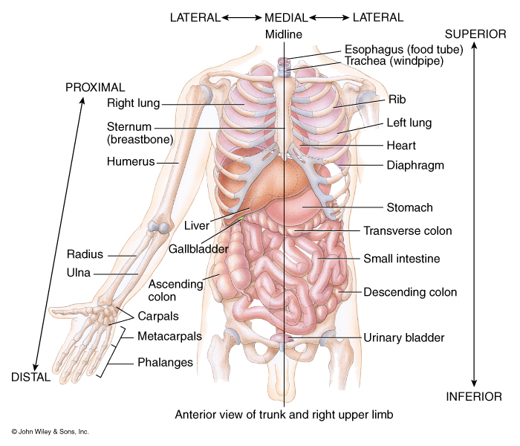
Directional Terms Used to Describe the Position of one Structure to Another
Superior/Inferior
(Cephalic/Caudal)
Anterior/Posterior
(Ventral/Dorsal)
Medial/Lateral
Intermediate: Between
Ipsilateral/Contralateral
Proximal/Distal
Superficial/Deep

Slide 39
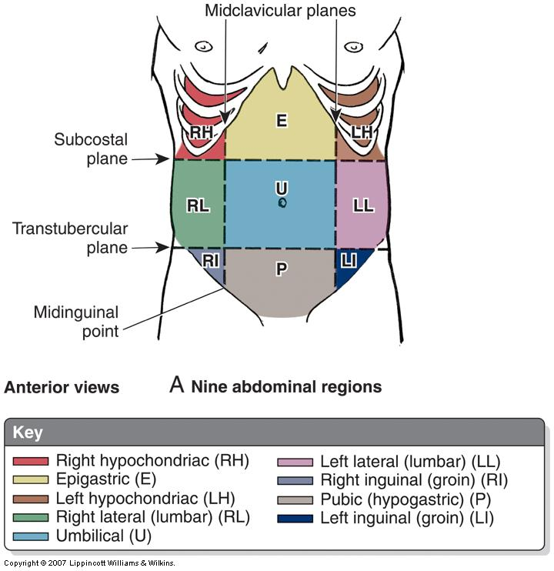

Slide 40
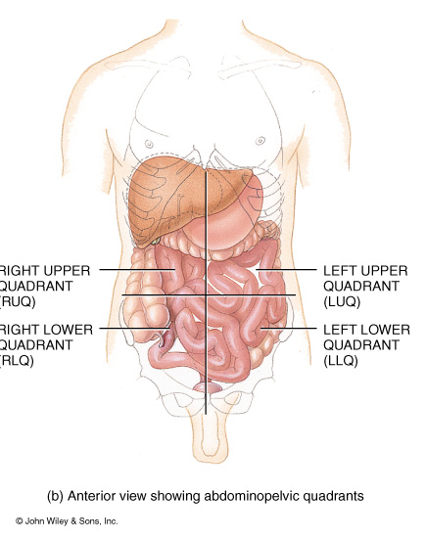
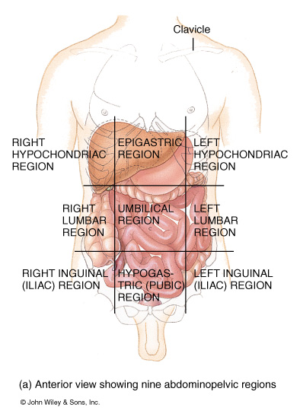
Methods of dividing the Abdominopelvic cavity

